Slide 1
Supermarket Sales Data Analysis & Statistical Validation
Tools Used:
Microsoft Power BI Desktop
Google Colab
Microsoft PowerPoint

Slide 2
Project Objective
Objective of the Project
The main objective of this project is to:
Analyze supermarket sales data
Identify sales trends and patterns
Visualize business insights using dashboards
Validate findings using statistical hypothesis testing

Slide 3
Dataset Description
Dataset Name: Supermarket Sales Dataset
Key Columns:
Invoice ID
Branch
City
Product Line
Quantity
Unit Price
Total Sales
Payment Method
Customer Rating
Total Records:
1000 transactions

Slide 4
Key Performance Indicators (KPIs)
Important KPIs analyzed:
Total Sales
Total Quantity Sold
Average Customer Rating
Sales by Product Line
Sales by Payment Method
These KPIs help understand overall business performance.

Slide 5
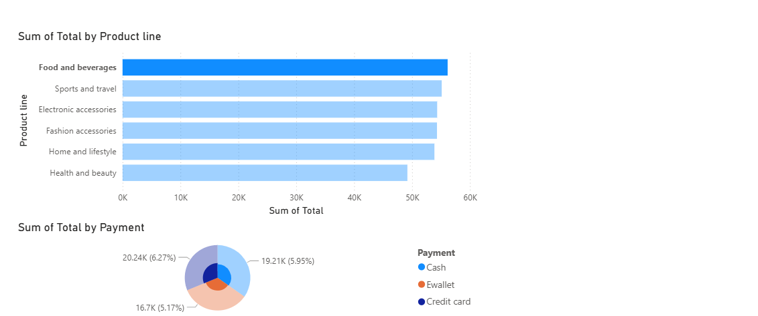
Power BI Dashboard
Dashboard created using Microsoft Power BI Desktop.
Visualizations included:
Sales by Product Line
Sales by City
Payment Method Distribution
Average Customer Rating
Monthly Sales Trend

Slide 6
Key Insights
Important insights discovered:
Food & Beverages generated high revenue.
Yangon branch had strong sales performance.
Digital payments like E-wallet are commonly used.
Customer ratings were mostly above average.

Slide 7
Hypothesis Statement
Business Question
Do customers using E-wallet spend more than customers using Cash?
Null Hypothesis (H₀):
There is no significant difference in total spending between Cash and E-wallet customers.
Alternative Hypothesis (H₁):
There is a significant difference in spending between the two payment methods.

Slide 8
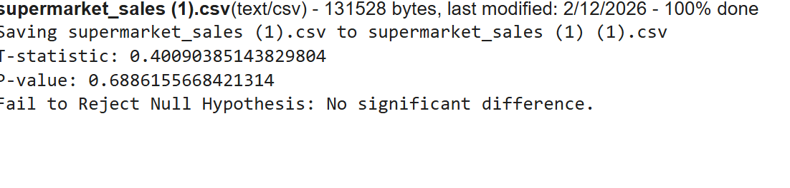
Statistical Testing
Hypothesis testing performed using Google Colab.
Test Used: Independent T-Test
Results
T-statistic = 0.4009
P-value = 0.6886

Slide 9
Result & Interpretation
Since:
P-value (0.6886) > 0.05
We fail to reject the null hypothesis.
Conclusion:
Payment method does not significantly affect customer spending.
Customers spend similar amounts regardless of payment type.

Slide 10
Conclusion & Recommendation
Conclusion
Sales patterns were identified through dashboards.
Statistical testing confirmed payment method has minimal impact on spending.
Recommendations
Focus marketing on high-selling product lines.
Maintain multiple payment options for customer convenience.
Use dashboards for continuous business monitoring.

